Slide 1

ASL to Text
Copyright by Jason Liu, Orfeo Terkuçi and Anass Hamzaoui

Slide 2
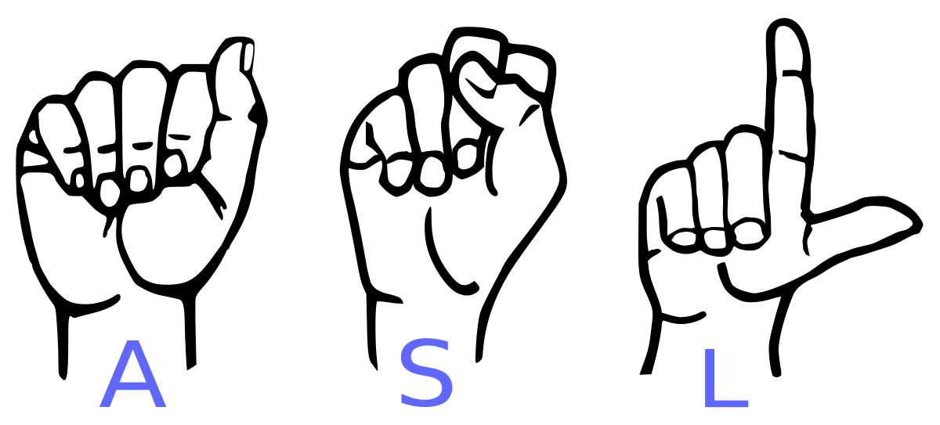
ASL?

Slide 3

Machine learning

Slide 4
Modelling
- Different models
- Benchmarking

Slide 5
Plan
Researching
Creating or finding a good dataset
Finding and creating different models
Testing the different models
Noting down or results

Slide 6
Motivation
- Learning
- Helping people

Slide 7
End result
?

